Slide 1
XLNet：Generalized Autoregressive Pretraining
for Language Understanding
Zhilin Yang, Zihang Dai，et al. Arxiv 19 June 2019
Bran
https://arxiv.org/abs/1906.08237

Slide 2
Content
Autoregression/Autoencoding Language Model
XLNet
Transformer-XL
Experiments
Conclusion

Slide 3

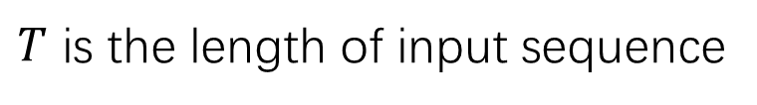
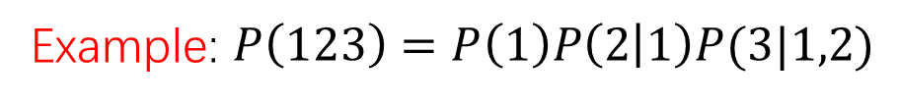
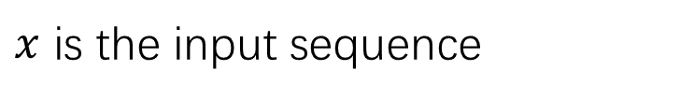
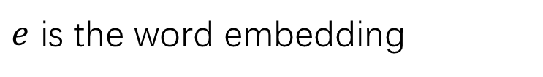
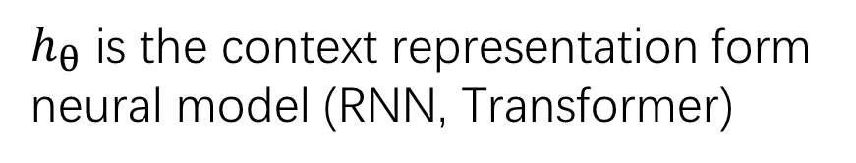
Autoregression(AR) Language Model
$x$ is the input sequence
$T$ is the length of input sequence
$h_{θ}$ is the context representation form neural model (RNN, Transformer)
$e$ is the word embedding
Example: $P\left(123\right)=P\left(1\right)P\left(2 | 1\right)P(3|1,2)$
Model: GPT
Notes:
What is regression, factories the likelihood into product

Slide 4

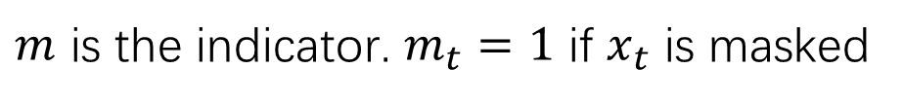
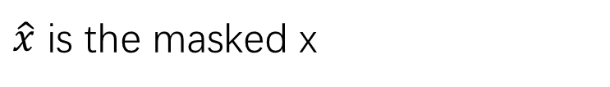
Autoencoding(AE) Language Model
$\hat{x}$ is the masked x
$m$ is the indicator. $m_{t}=1$ if $x_{t}$ is masked
Model: BERT
Notes:
Approximate equal

Slide 5
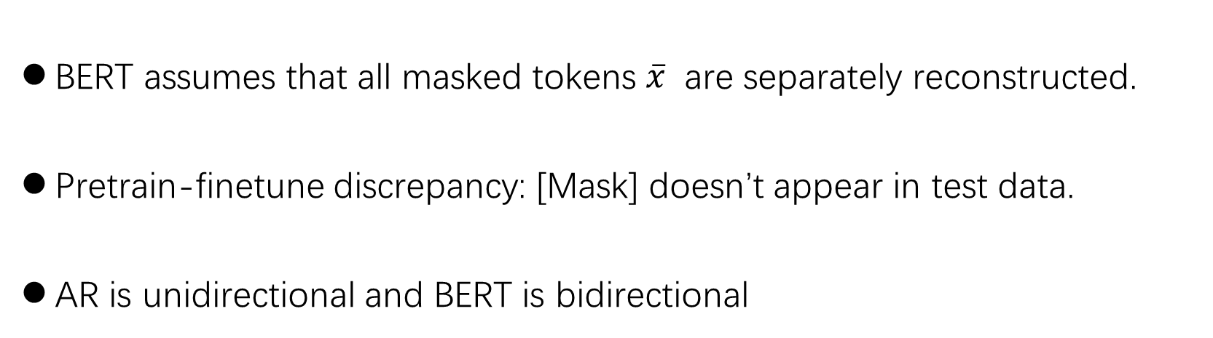
Cons and pros
BERT assumes that all masked tokens $\overline{x}$ are separately reconstructed.
Pretrain-finetune discrepancy: [Mask] doesn’t appear in test data.
AR is unidirectional and BERT is bidirectional
Notes:
Distribution is not matched

Slide 6
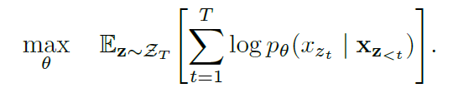
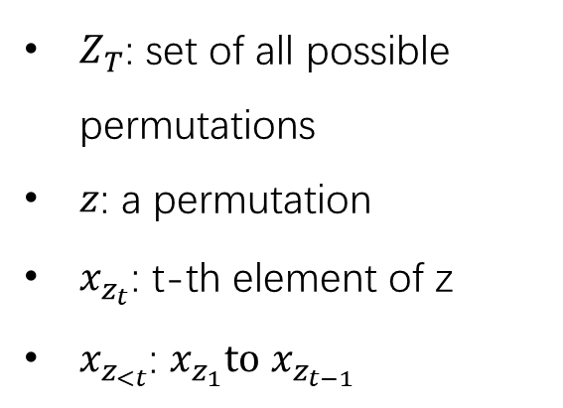
XLNet
XLNet want to let the AR language model can capture bidirectional context, so it can brings the advantages of both while avoiding their weaknesses
Idea
$Z_{T}$: set of all possible permutations
$z$: a permutation
$x_{z_{t}}$: t-th element of z
$x_{z_{<t}}$: $x_{z_{1}}to$ $x_{z_{t−1}}$
Propose a new objective
Notes:
expecation

Slide 7
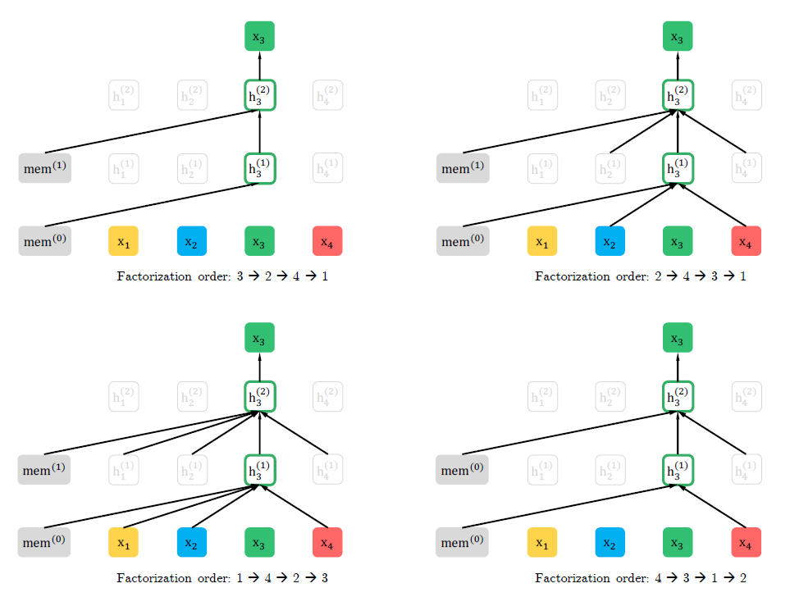
XLNet
Notes:
Predict x3, different factorization order, sequence order is the same , position embedding is the same, because we just change the order of factorization instead of order of sequence
Now predict x3 we have all context and it is still AR

Slide 8
XLNet
My understanding of XLNet:
XLNet is to train T! models with shared parameters. Each model is bound to one factorization.
The objective is to restrict the model to find the max expectation of likelihood of these models.
Notes:
expectation

Slide 9
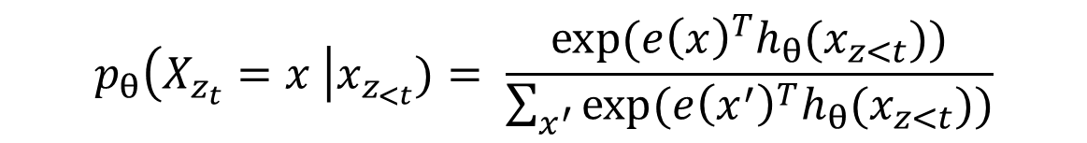
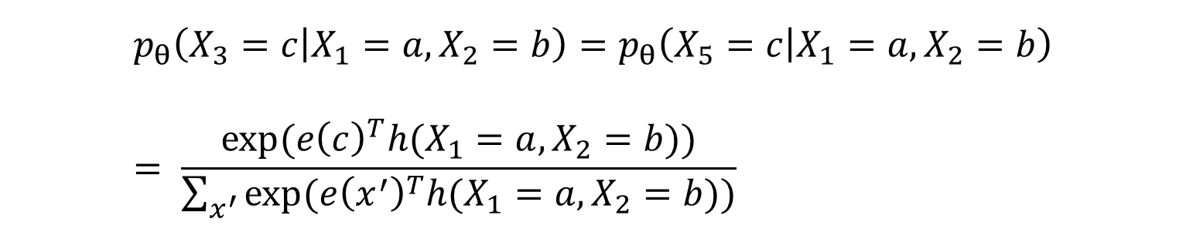
XLNet: Two-Stream Self-Attention
New problem: the standard Transformer is not work
$$X=\left(a,b,c,d,c\right), { z}^{(1)}=\left[1,2,3,4,5\right],{ z}^{(2)}=\left[1,2,5,4,3\right]$$
$$p_{θ}\left(X_{z_{t}}=x \right|x_{z_{<t}})= \frac{exp⁡({e\left(x\right)}^{T}h_{θ}(x_{z<t}))}{\sum_{x^{′}}{exp⁡({e\left(x^{′}\right)}^{T}h_{θ}(x_{z<t}))}}$$
$$p_{θ}\left(X_{3}=c | X_{1}=a,X_{2}=b\right)=p_{θ}\left(X_{5}=c | X_{1}=a,X_{2}=b\right)= \frac{exp⁡({e\left(c\right)}^{T}h(X_{1}=a,X_{2}=b))}{\sum_{x^{′}}{exp⁡({e\left(x^{′}\right)}^{T}h(X_{1}=a,X_{2}=b))}}$$

Slide 10

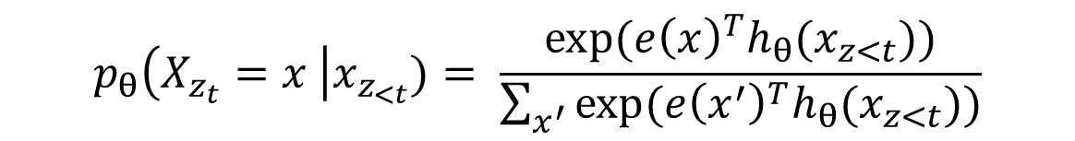
Two-Stream Self-Attention
$$p_{θ}\left(X_{z_{t}}=x \right|x_{z_{<t}})= \frac{exp⁡({e\left(x\right)}^{T}h_{θ}(x_{z<t}))}{\sum_{x^{′}}{exp⁡({e\left(x^{′}\right)}^{T}h_{θ}(x_{z<t}))}}$$

Slide 11
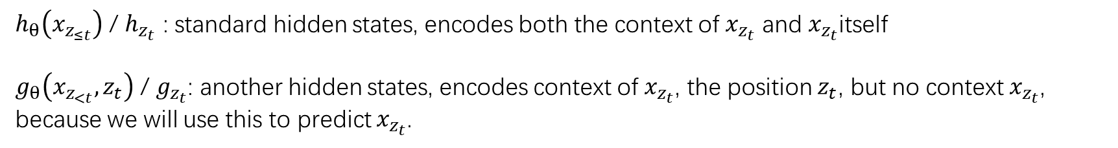

Two-Stream Self-Attention
$h_{θ}\left(x_{z_{≤t}}\right)$ / $h_{z_{t}}$ : standard hidden states, encodes both the context of $x_{z_{t}}$ and $x_{z_{t}}$itself
$g_{θ}\left(x_{z_{<t}}, z_{t}\right)$ / $g_{z_{t}}$: another hidden states, encodes context of $x_{z_{t}}$, the position $z_{t}$, but no context $x_{z_{t}}$, because we will use this to predict $x_{z_{t}}$.
Initial: $g_{i}^{(0)}=w$, $h_{i}^{(0)}=e(x_{i})$

Slide 12
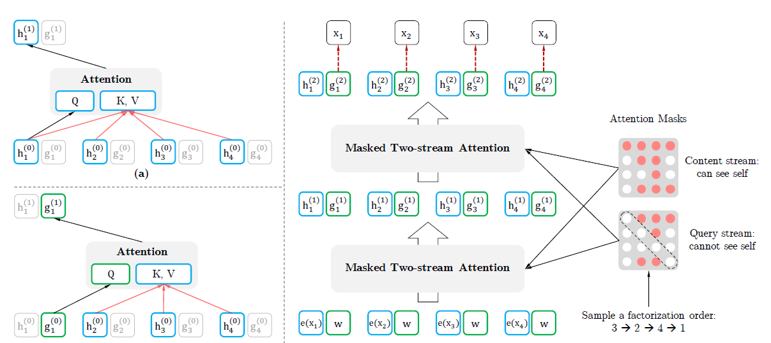
Two-Stream Self-Attention

Slide 13

Partial Prediction
Only predict the last tokens in a factories
Notes:
C cutting point , only predict the last tokens in a factories

Slide 14
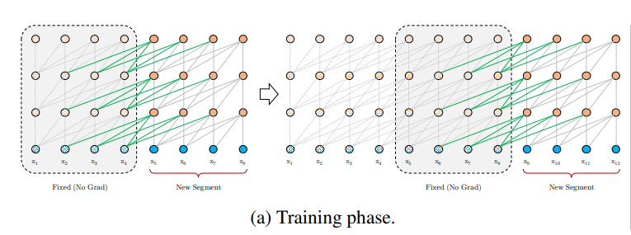
Transformer-XL
Advantage:
Long-term dependency,
Transformer-XL is 80% longer than RNNs
RNNs is 150% longer than standard Transformers
the segment recurrence mechanism
Relative positional encoding
https://arxiv.org/abs/1901.02860
Notes:
The name of xlnet, semester, the advantage of transformer-xl, long-term dependency 80%, 50, 200

Slide 15
Modeling Multiple Segments
This part is very similar to BERT
Notes:
The name of xlnet, semester, the advantage of transformer-xl, long-term dependency 80%, 50, 200

Slide 16
Experiments
Data
BERT: BooksCorpus(0.8B words) English Wikipedia(2.5B words) 3.3B in total
XLNet: Wikipedia(2.78B), BooksCorpus(1.09B), Giga5(4.75B),
ClueWeb(4.3B), and Common Crawl(19.97B), 32.89B in total.
Training time
BERT: 1024 * TPU v3 76 mins
XLNet: 512 * TPU v3 2.5 days
Model Size
Similar (BERT, 340M parameters)

Slide 17
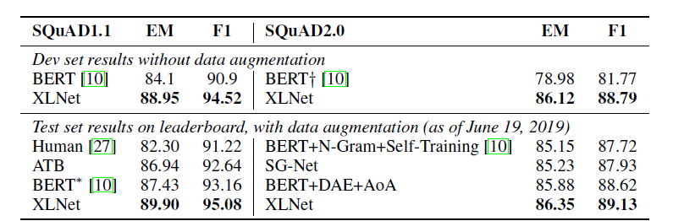
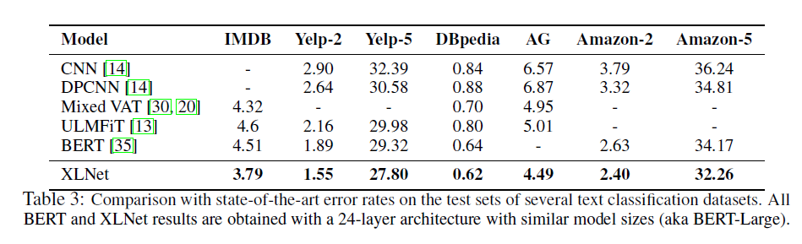
Results
XLNet outperforms
BERT on 20 tasks

Slide 18
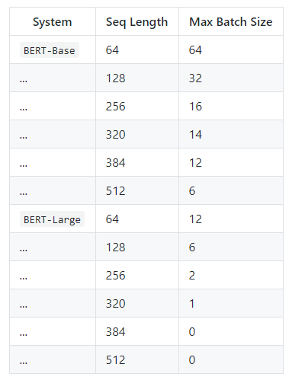
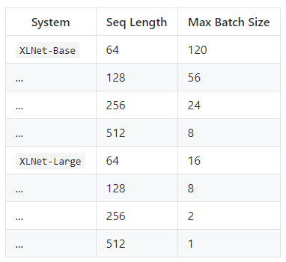
Requirement to train
BERT on titan x (12G)
XLNet on single GPU (16G)

Slide 19
Conclusion
XLNet is a generalized AR pretraining method that uses a permutation language modeling objective to combine the advantages of AR and AE methods.
The idea inside this model may be helpful for us to improve our work
There is still room for improvement on pre-trained language model

Slide 20
Thanks

